Slide 1
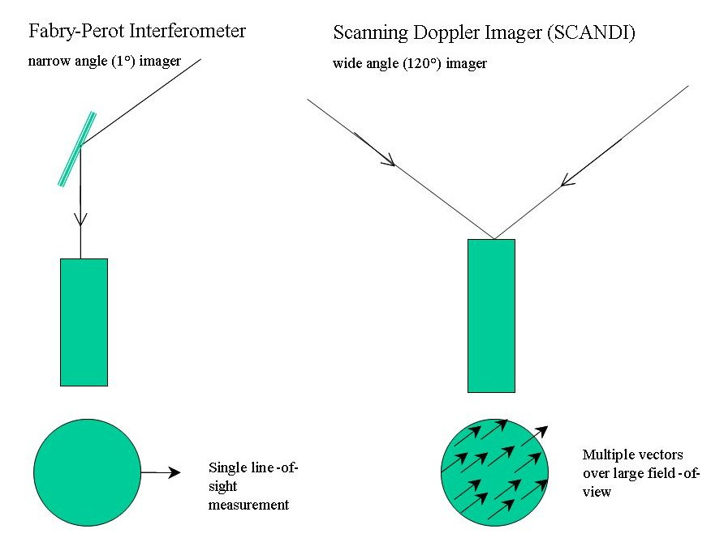
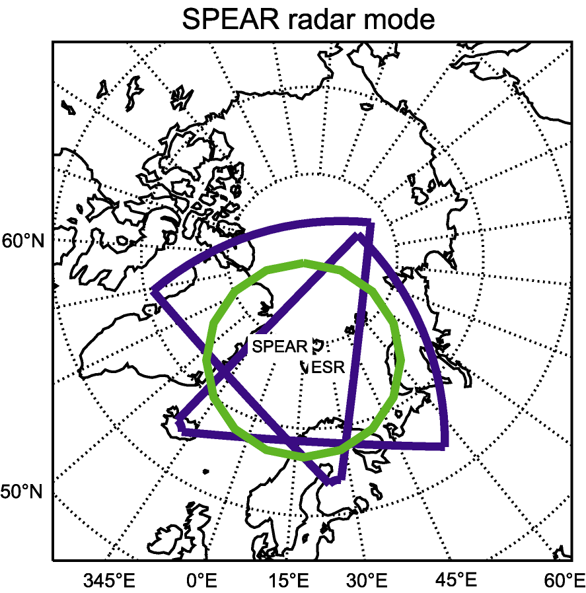
SCANDI: All sky imaging of wind and temperature fields using state-of-the-art CCD technology
ESR, SPEAR and CUTLASS
SCANDI
Notes:
C:\Users\McQuaid\Documents\Anasuya\conferences\IAGA Bulgaria 2006
IAGA06_Aruliah.ppt

Slide 2
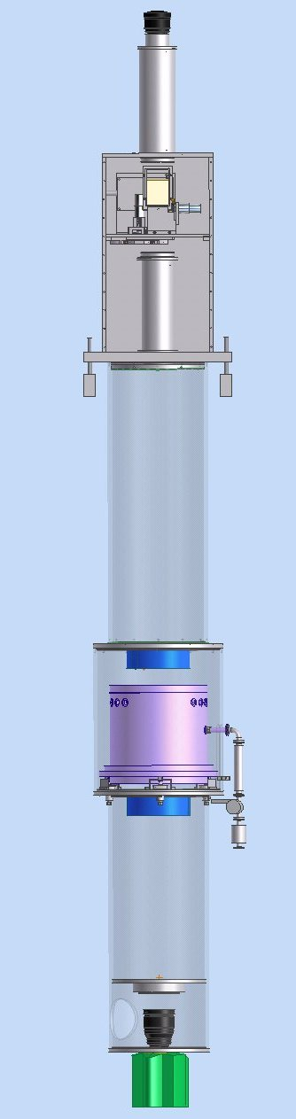
Fish-eye lens
SCANDI
A Scanning Doppler Imager
For Scandinavia
Collimator
Filter wheel
& calibration
panel
Beam expander
3m
SCANDI will provide
a 25-zone all-sky map
of winds and temperatures in the thermosphere by measuring the
630nm oxygen emission line.
It combines many consecutive
images, for which it relies
on the high frame rate and
low s/n ratio of EMCCDs
Capacitance
- stabilised
scanning etalon
Telescope
Andor iXon camera
Notes:
C:\Users\McQuaid\Documents\Anasuya\conferences\IAGA Bulgaria 2006
IAGA06_Aruliah.ppt

Slide 3
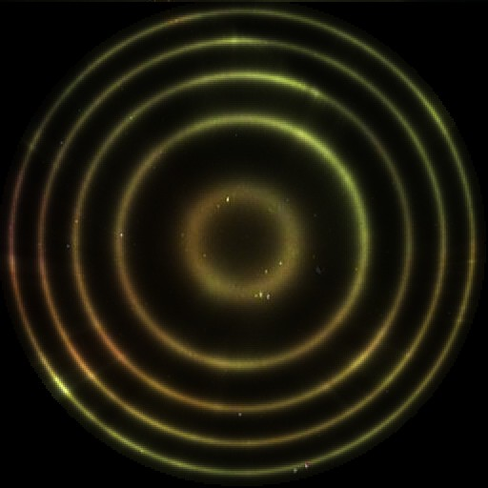
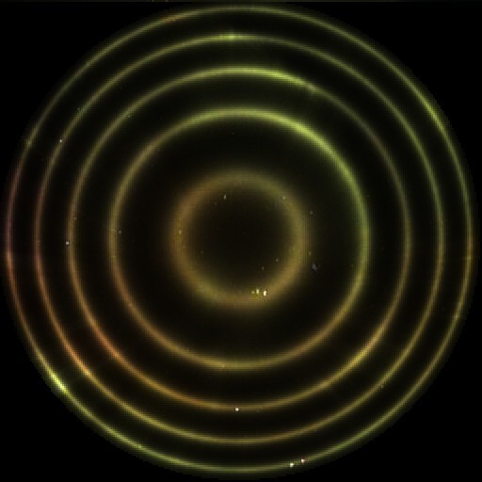
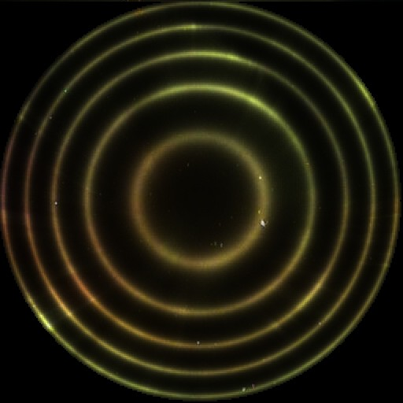
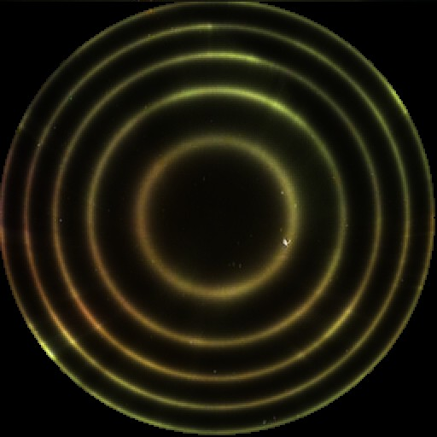
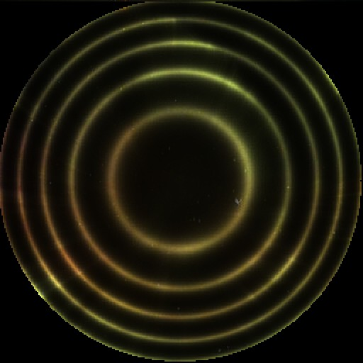
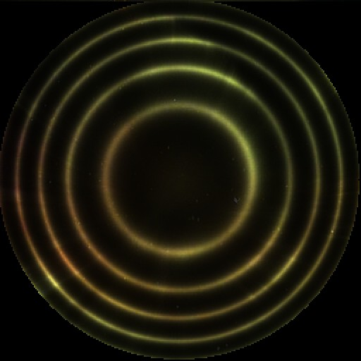

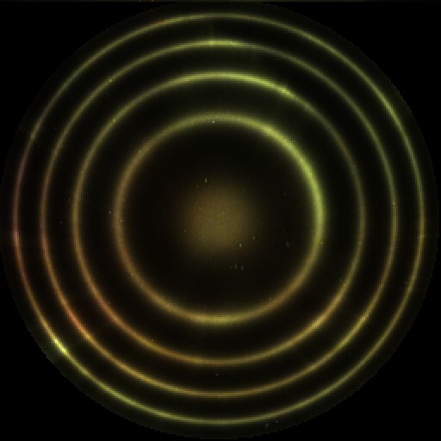
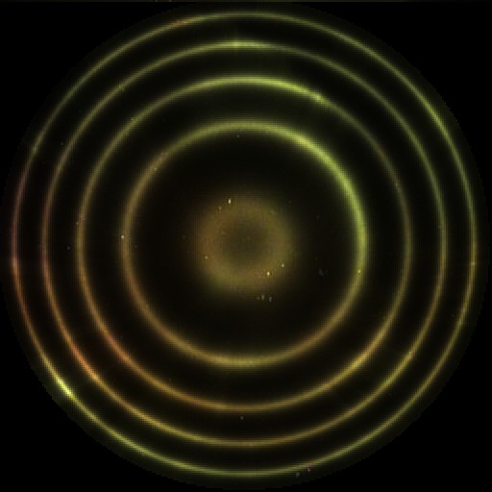

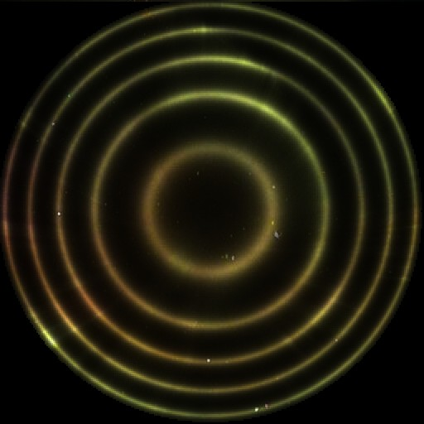
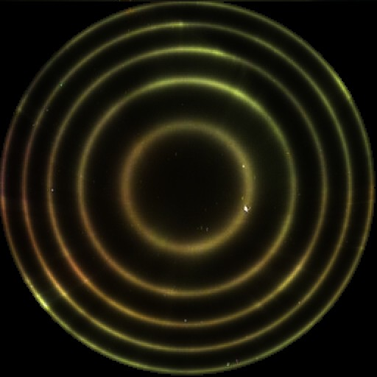

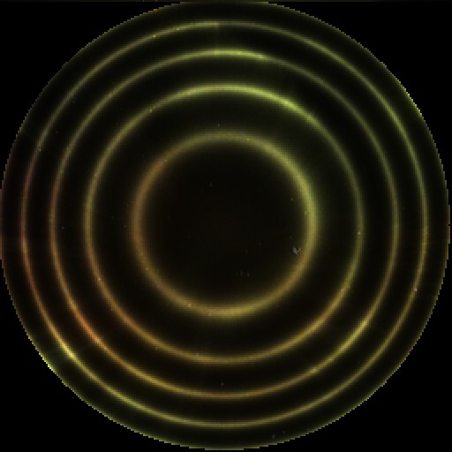


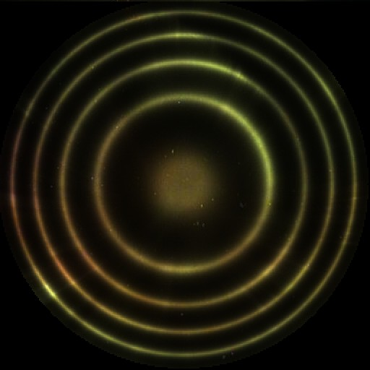




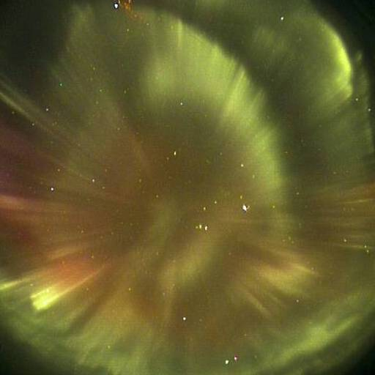
Notes:
C:\Users\McQuaid\Documents\Anasuya\conferences\IAGA Bulgaria 2006
IAGA06_Aruliah.ppt

Slide 4
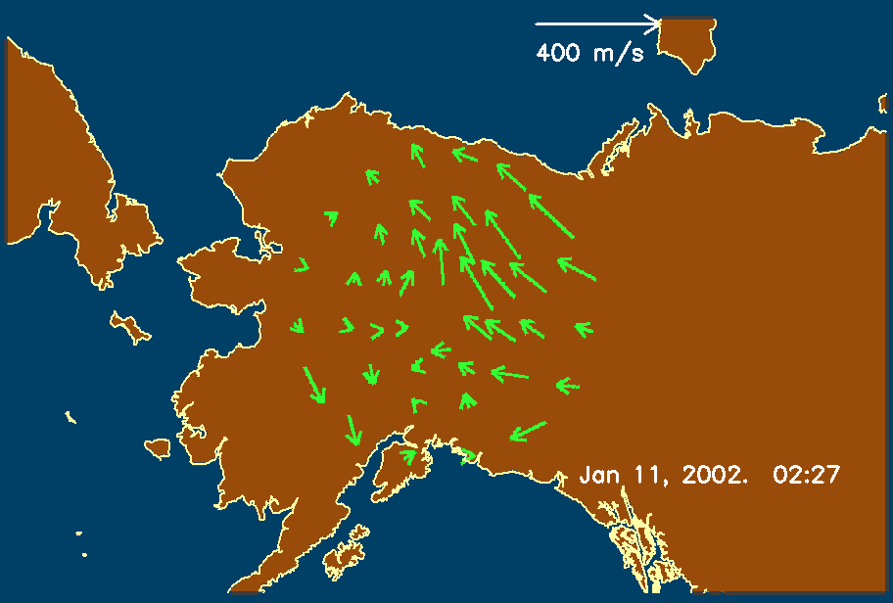
Alaska Scanning Doppler Imager
(Mark Conde, La Trobe University)
Notes:
C:\Users\McQuaid\Documents\Anasuya\conferences\IAGA Bulgaria 2006
IAGA06_Aruliah.ppt

